Slide 1
Angle Relations
(8th)I CAN find the unknown measurement of different types of angles.
MGSE7.G.5-Use facts about supplementary, complementary, vertical, and adjacent angles in a multi-step problem to write and solve simple equations for an unknown angle in a figure. (Review)
MGSE8.G.5-Use informal arguments to establish facts about the angle sum and exterior angle of triangles, about the angles created when parallel lines are cut by a transversal, and the angle‐ angle criterion for similarity of triangles.

Slide 2
Lesson: Angle Relations
Teacher will review the vocabulary: supplementary, complementary, adjacent, and vertical angles using a foldable. Teacher will use a PowerPoint while students follow along with their foldable.

Slide 3
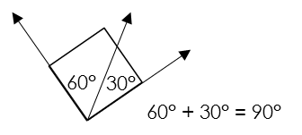
Complementary Angles
Definition Two or more angles that add up to ______ (a _________ Angle) are complementary.
A Way to Remember The “C” in complementary stands for “corner” (right angle).
Example

Slide 4
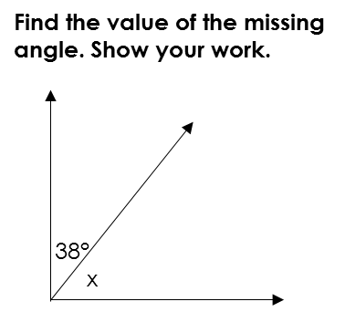
Complementary Angles: Practice

Slide 5
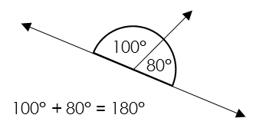
Supplementary Angles
Definition Two or more angles that add up to ______ (a ____________ Angle) are supplementary.
A Way to Remember The “S” in supplementary stands for “straight” (straight angle).
Example

Slide 6
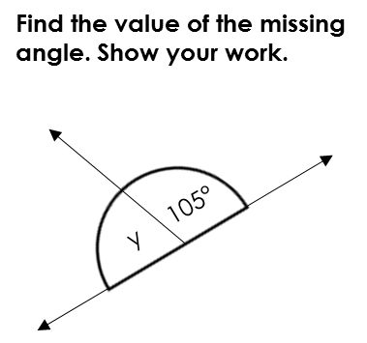
Supplementary Angles: Practice

Slide 7
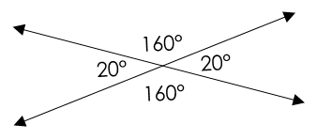
Opposite Angles
Definition Opposite angles are angles ________________ from each other when two lines cross. Their angle measures are the ___________.
A Way to Remember Think about opposite angles being across each other.
Example

Slide 8
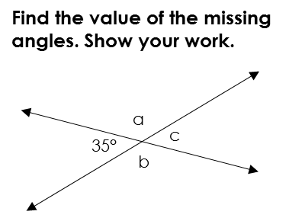
Opposite Angles: Practice

Slide 9
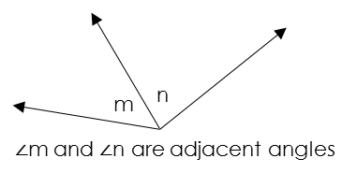
Adjacent Angles
Definition Two angles that ___________ a side and a point are adjacent.
A Way to Remember Think about adjacent angles being next door neighbors of each other.
Example

Slide 10
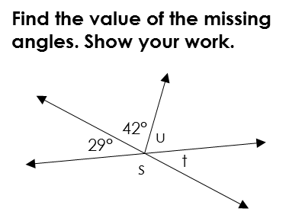
Adjacent Angles: Practice

Slide 11
Answer Key (in order of slides)
1. Complementary Angles
90°, right
2. Complementary Angles
52°
3. Supplementary Angles
180°, straight
4. Supplementary Angles
75°
5. Vertical Angles
opposite, same
6. Vertical Angles
35°, 145°, 145°
7. Adjacent Angles
share, next to
8. Adjacent Angles
s = 151°, 29°, 109°

